Slide 1
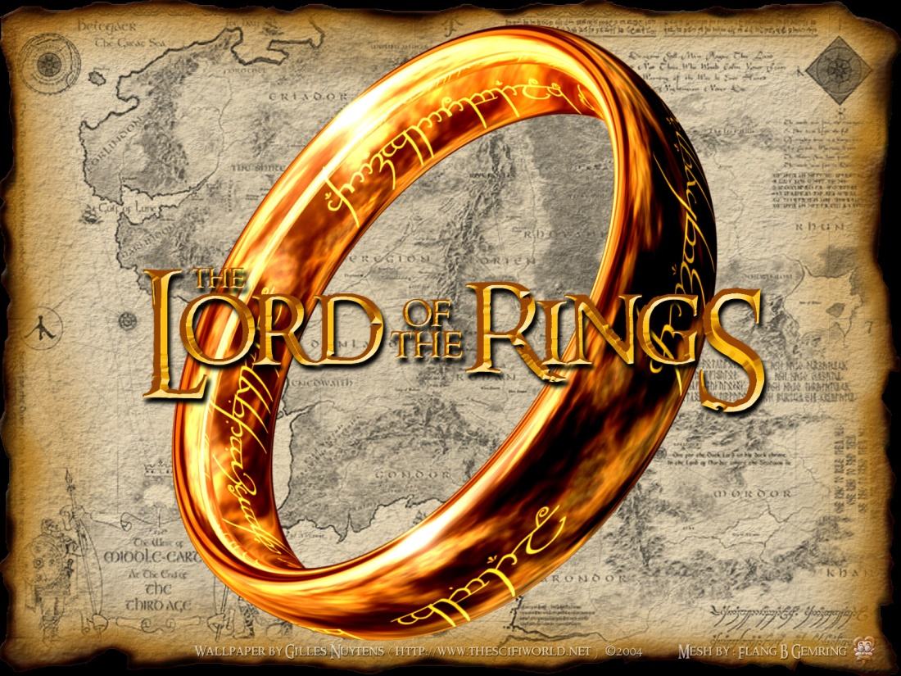
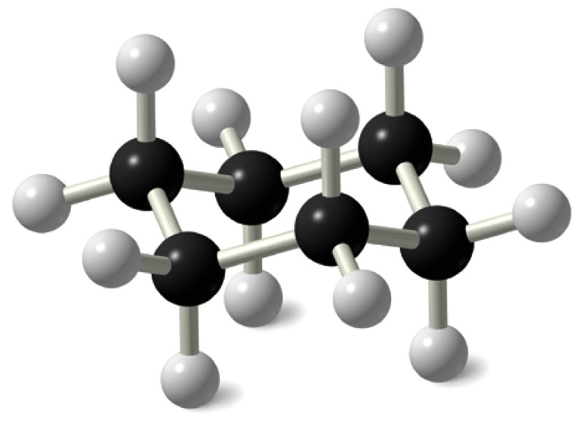
Cyclohexane
Cyclohexane, the true Lord of the Rings (in organic chemistry; mastering it will give you great power indeed!)
Lord of the Rings in Middle Earth. The bearer has immense power, but it’s all fantasy.

Slide 2
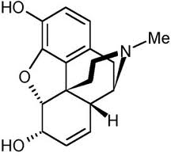
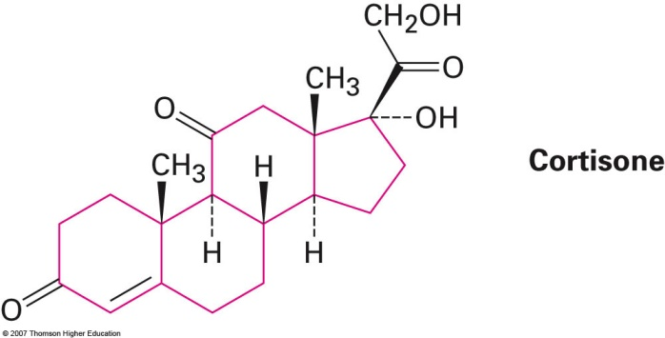
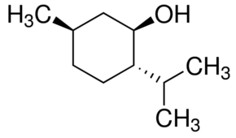
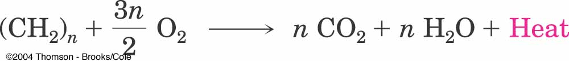
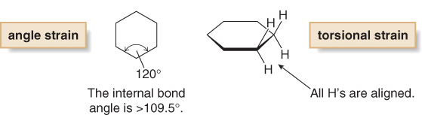
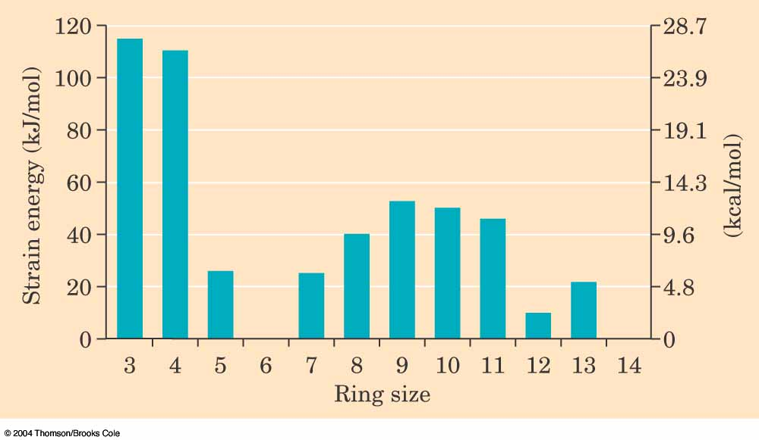
Cyclohexane
Substituted cyclohexanes occur widely in nature
Menthol
Morphine
If cyclohexane ring were flat, there would be angle strain as well as torsional strain….BUT it has none!

Slide 3
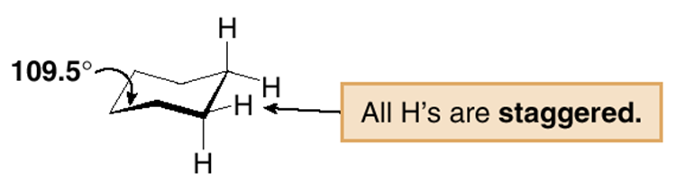
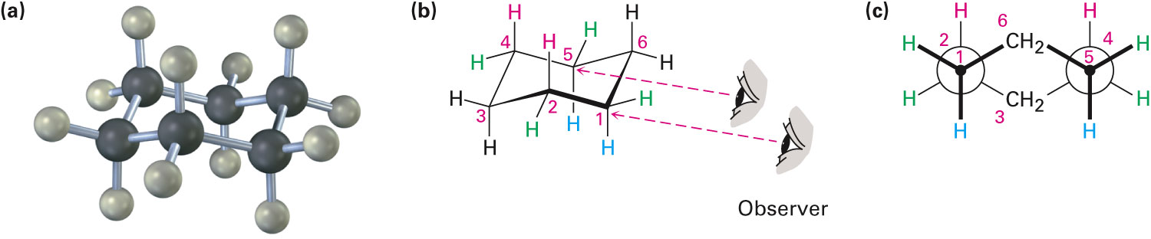
Cyclohexane Conformation
In reality, cyclohexane adopts a puckered “chair” conformation, which is more stable than any possible other conformation.
The chair conformation is so stable because it eliminates angle strain (all C—C—C angles are 109.5°), and torsional strain (all hydrogens on adjacent C atoms are staggered).

Slide 4
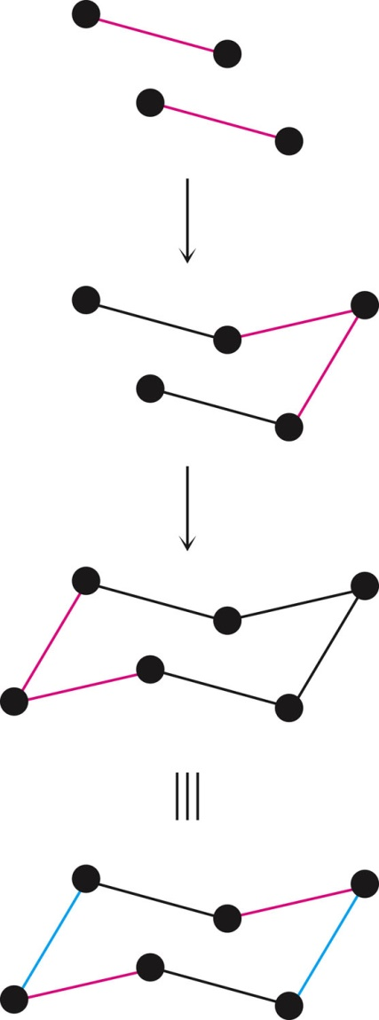
How to Draw Cyclohexane Chair Conformation
Step 1 Draw two parallel lines, slanted downward and slightly offset from each other. This means that four of the cyclohexane carbons lie in a plane.
Step 2 Place the topmost carbon atom above and to the right of the plane of the other four, and connect bonds.
Step 3 Place the bottommost carbon atom below and to the left of the plane of the middle four, and connect the bonds. Note that the bonds to the bottommost carbon atom a parallel to the bonds to the topmost carbon.

Slide 5
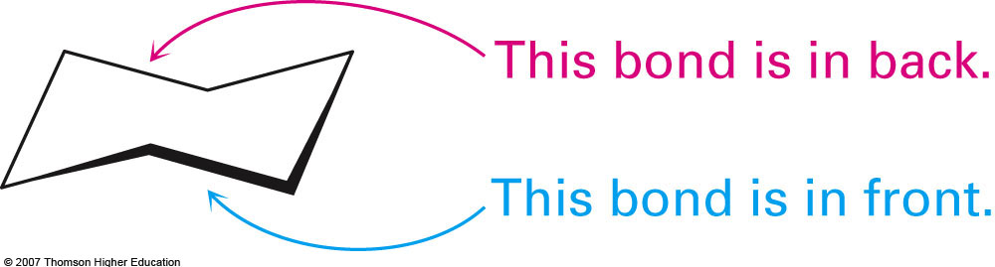
The Way Cyclohexane is Drawn in Most Books

Slide 6
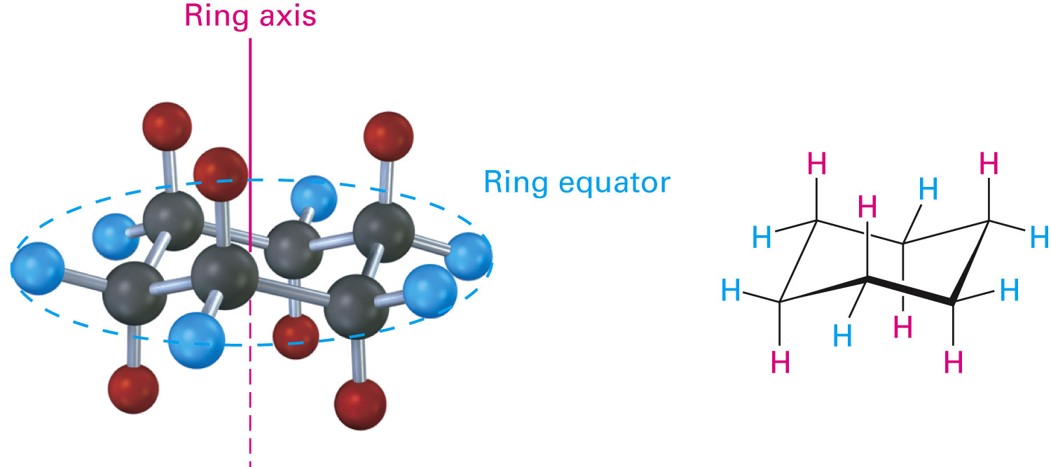
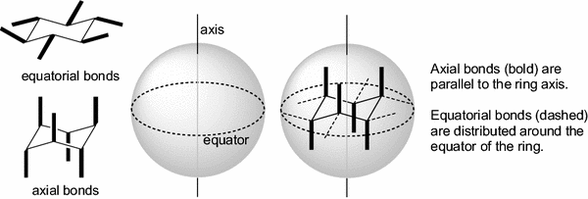
Stereochemical Disposition of Substituents

Slide 7
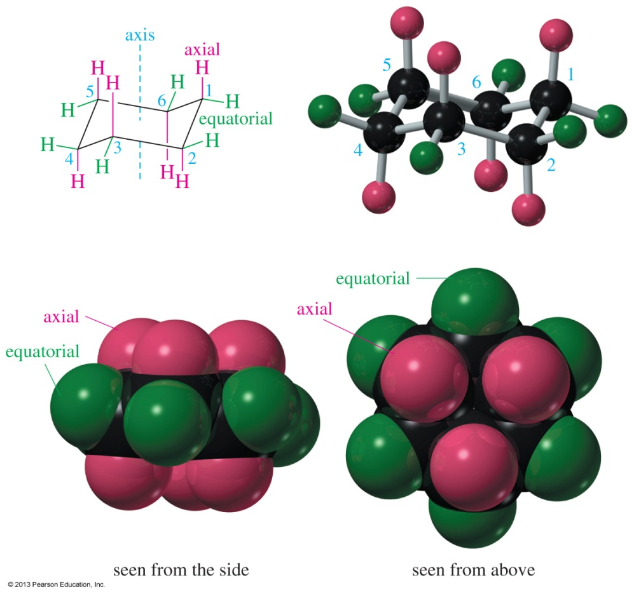
Axial and Equatorial Substituents
Axial bonds (red) are directed vertically parallel to the axis of the ring.
Equatorial bonds (green) are directed outward toward the equator of the molecule.

Slide 8
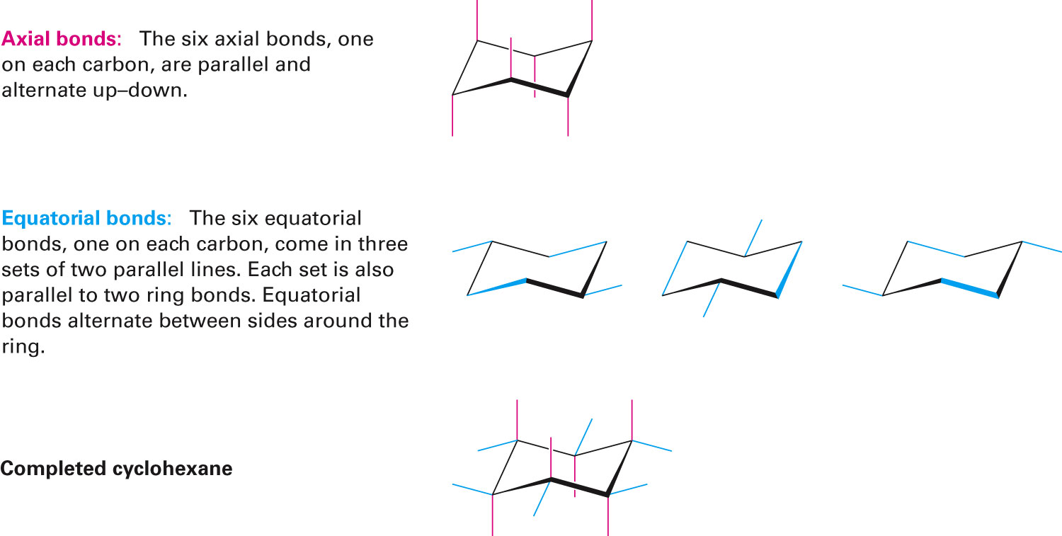
Drawing the Substituents

Slide 9
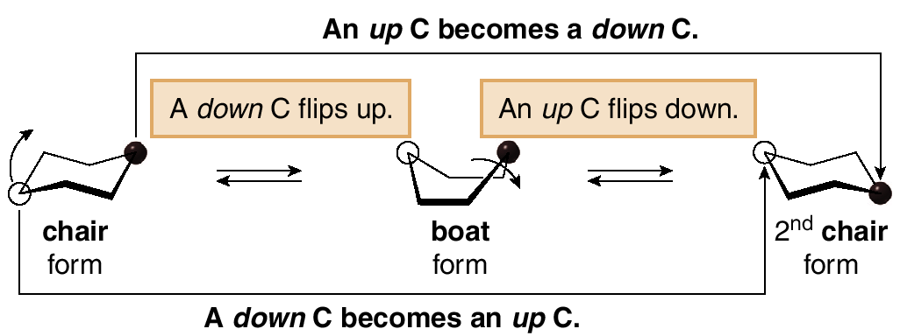
Ring Flipping of Cyclohexane
An important conformational change in cyclohexane involves “ring-flipping.”
As a result of a ring flip, the “up” carbons become “down” carbons, and the “down” carbons become “up” carbons.

Slide 10
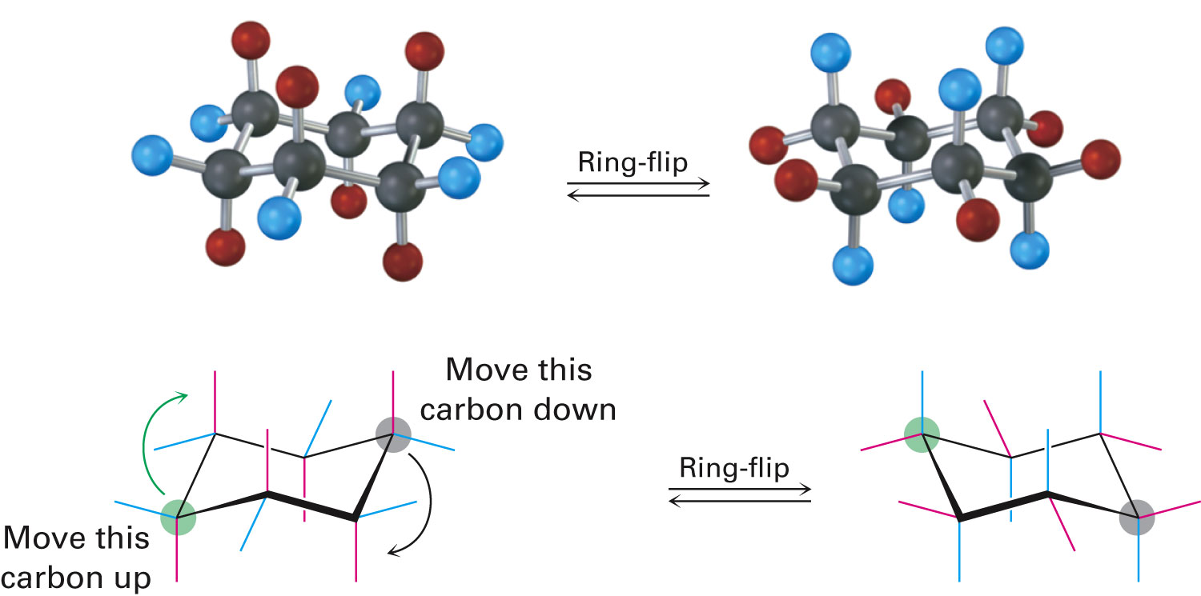
Ring-Flipping of Cyclohexane
Chair conformations readily interconvert, resulting in the exchange of axial and equatorial positions by a ring-flip.

Slide 11
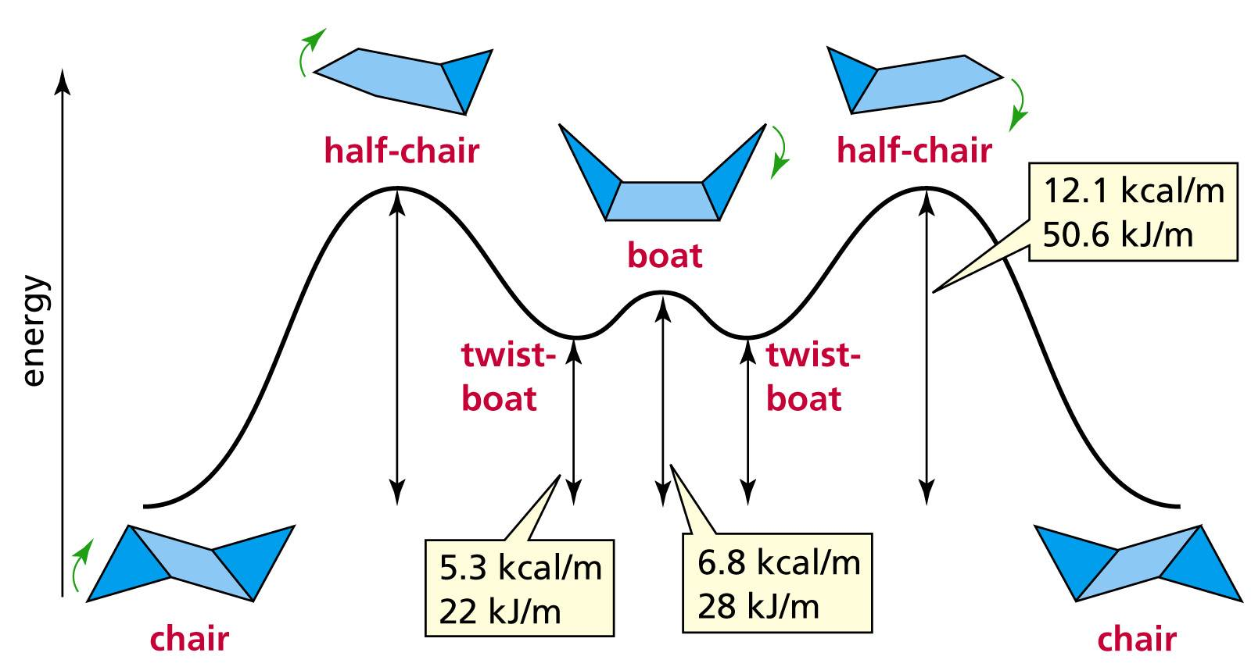
Ring-Flip Costs Energy
The two chair conformations are of equal energy.
Ring-flipping proceeds through a number of other higher energy conformations such as half-chair, twist-boat, and boat.

Slide 12
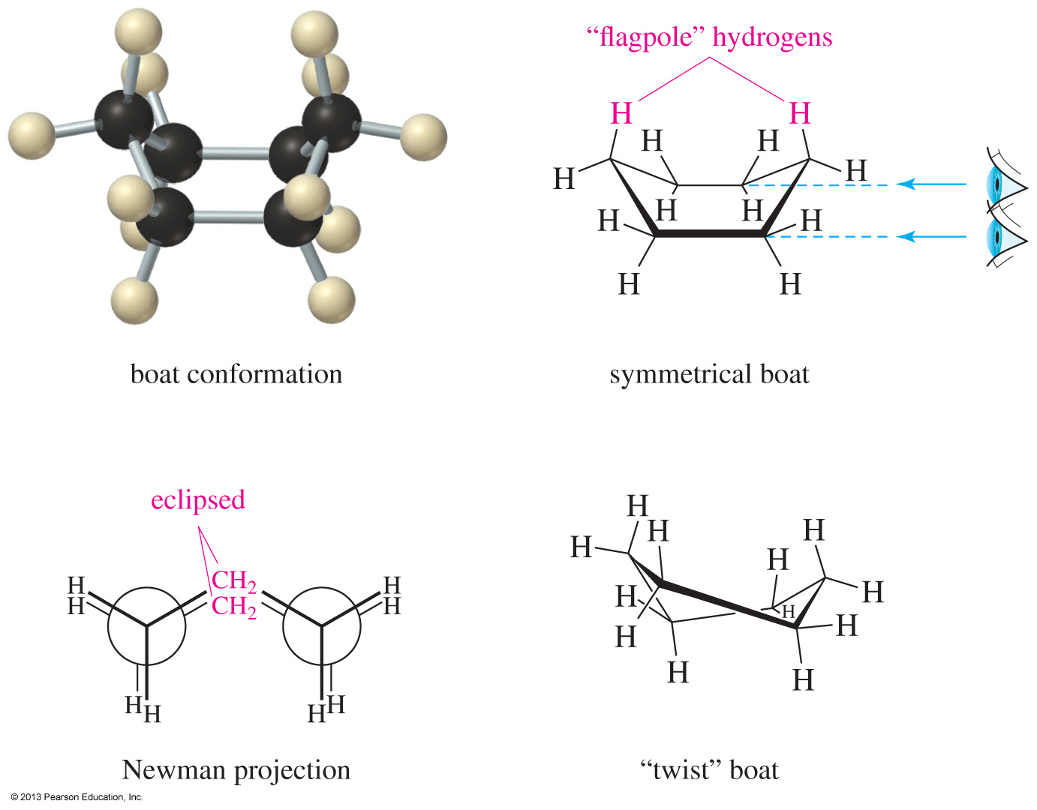
Boat and Twist-Boat Conformations
In the boat conformation, there is no angle strain but eclipsing bonds result in torsional strain.
The twist boat conformation has fewer eclipsing bond interactions and less interference between the flagpole hydrogens.

Slide 13
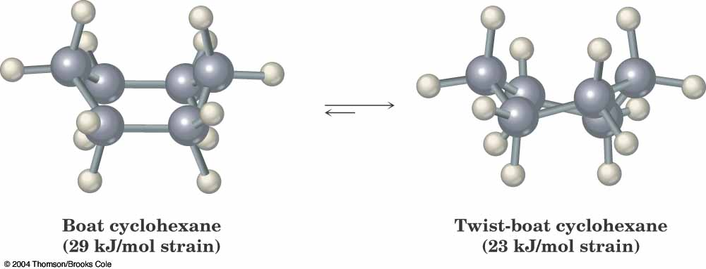
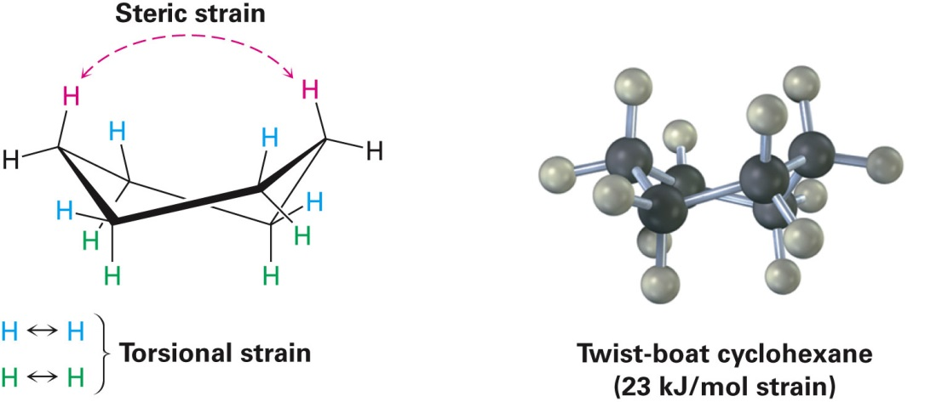
Boat And Twist Boat Conformations
Boat
No angle strain
High torsional strain
High steric strain
Very unstable
Twist-boat
Relieves some torsional and
steric strain
No angle strain
Lower E than boat
Higher E than chair

Slide 14
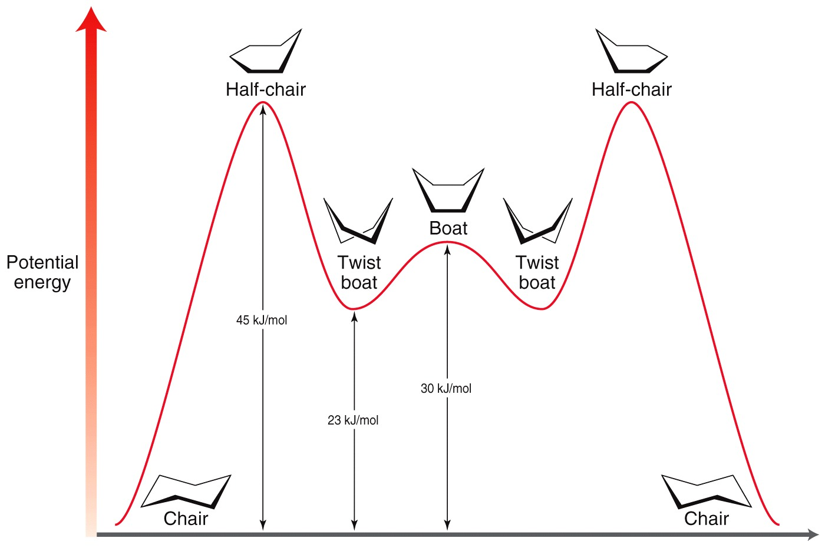
Overall Picture
The cyclohexane continuously flips from one chair conformation to the other. Half-chair conformation is unstable. Approximately 1 million such interconversions occur every second. More than 99% of the molecules are estimated to be in a chair conformation at any given time.

Slide 15
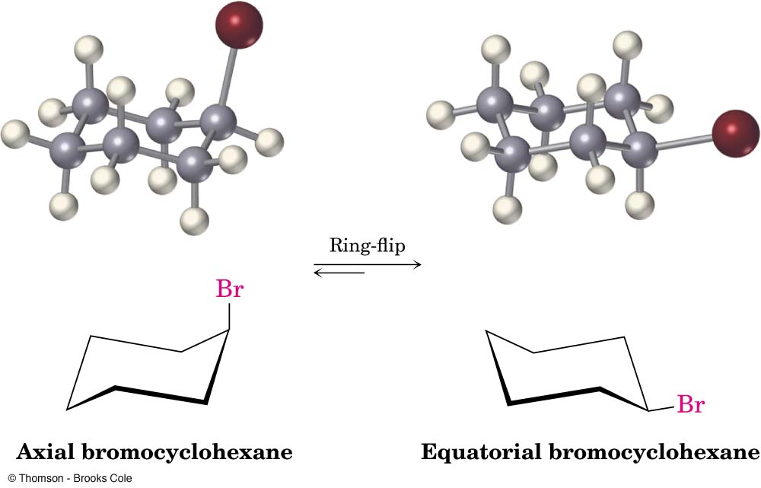
Example: Axial-Equatorial Switch of Substituents Upon Ring Flipping
Ring-flipping in bromocyclohexane results in the bromine being switched from axial to equatorial and vice-versa
Notice which conformation is favoured!

Slide 16
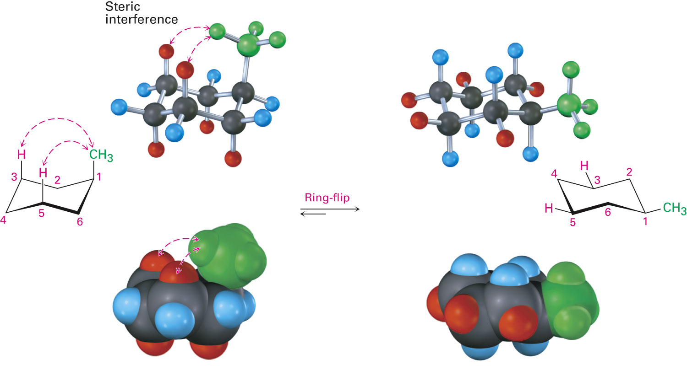
Methylcyclohexane
Two conformations of monosubstituted cyclohexane aren’t equally stable.
The equatorial conformer of methyl cyclohexane is more stable than the axial by 7.6 kJ/mol

Slide 17
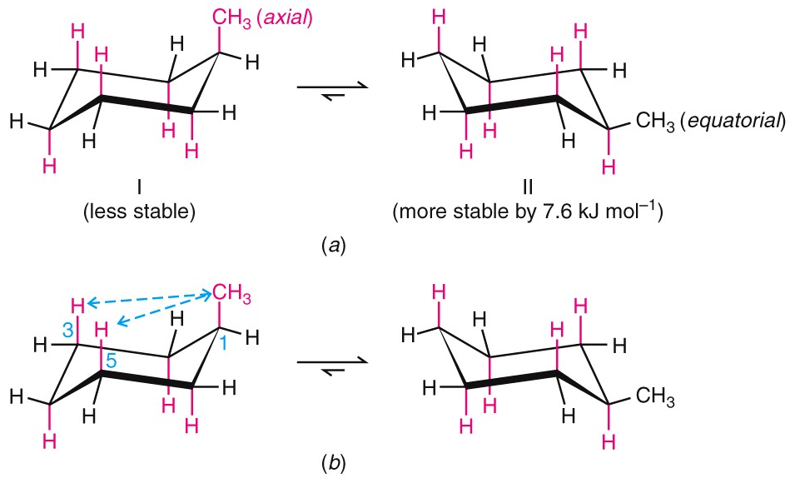
1,3-Diaxial Interactions
Difference between axial and equatorial conformers is due to steric strain caused by 1,3-diaxial interactions
Hydrogen atoms of the axial methyl group on C1 are too close to the axial hydrogens three carbons away on C3 and C5, resulting in 7.6 kJ/mol of steric strain
1,3-diaxial interactions

Slide 18
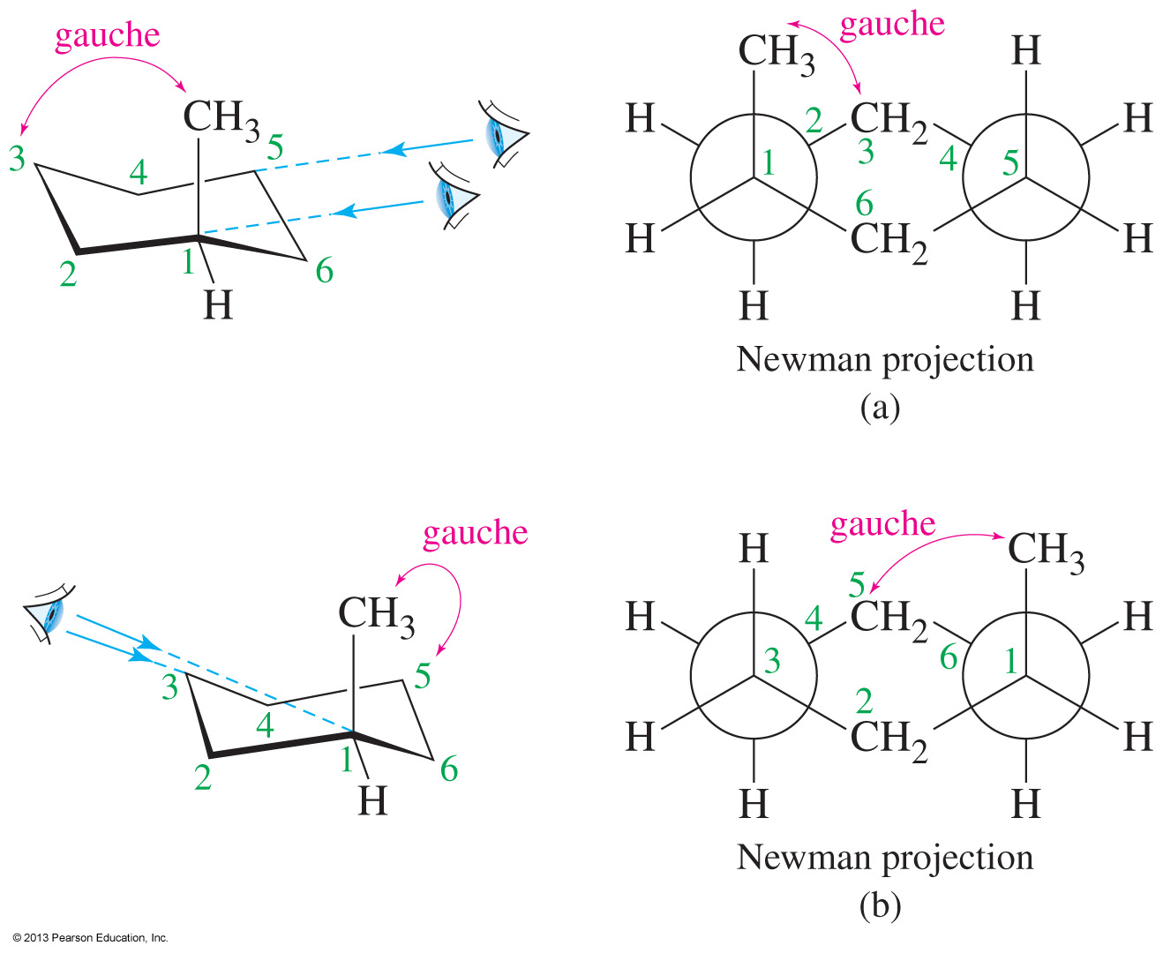
Implications of Axial Methyl Group
When the methyl substituent is in an axial position on C1, it is gauche to C3 as well as to C5 of the ring.

Slide 19
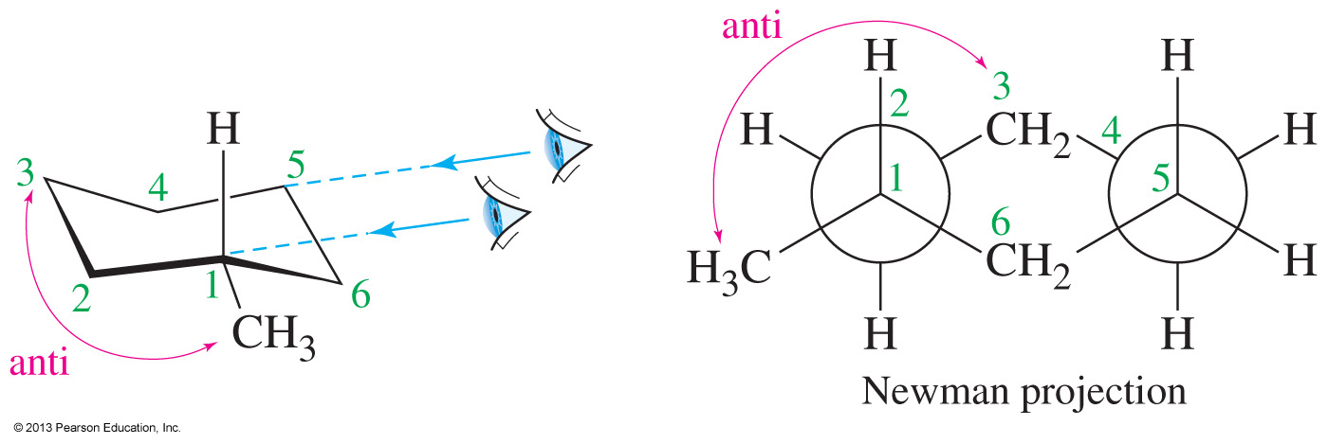
Implications of Equatorial Methyl Group
An equatorial methyl group will be anti to the C3.
This conformation is lower in energy and favoured over the conformation with the methyl in the axial position

Slide 20
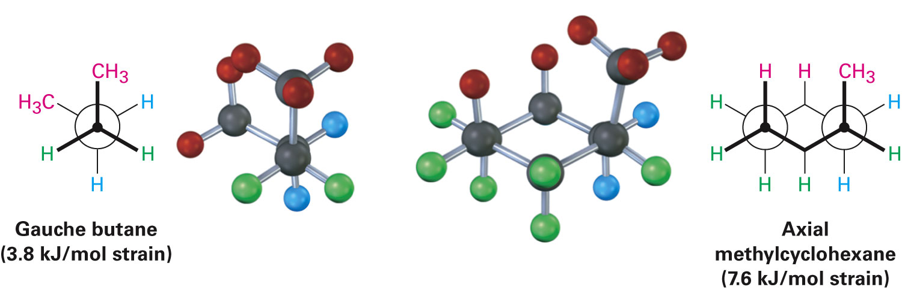
Relationship to Gauche Butane Interactions
Gauche butane is less stable than anti butane by 3.8 kJ/mol because of steric interference between hydrogen atoms on the two methyl groups
The four-carbon fragment of axial methylcyclohexane and gauche butane have the same steric interaction
In general, substituents at equatorial positions are the more stable isomer

Slide 21
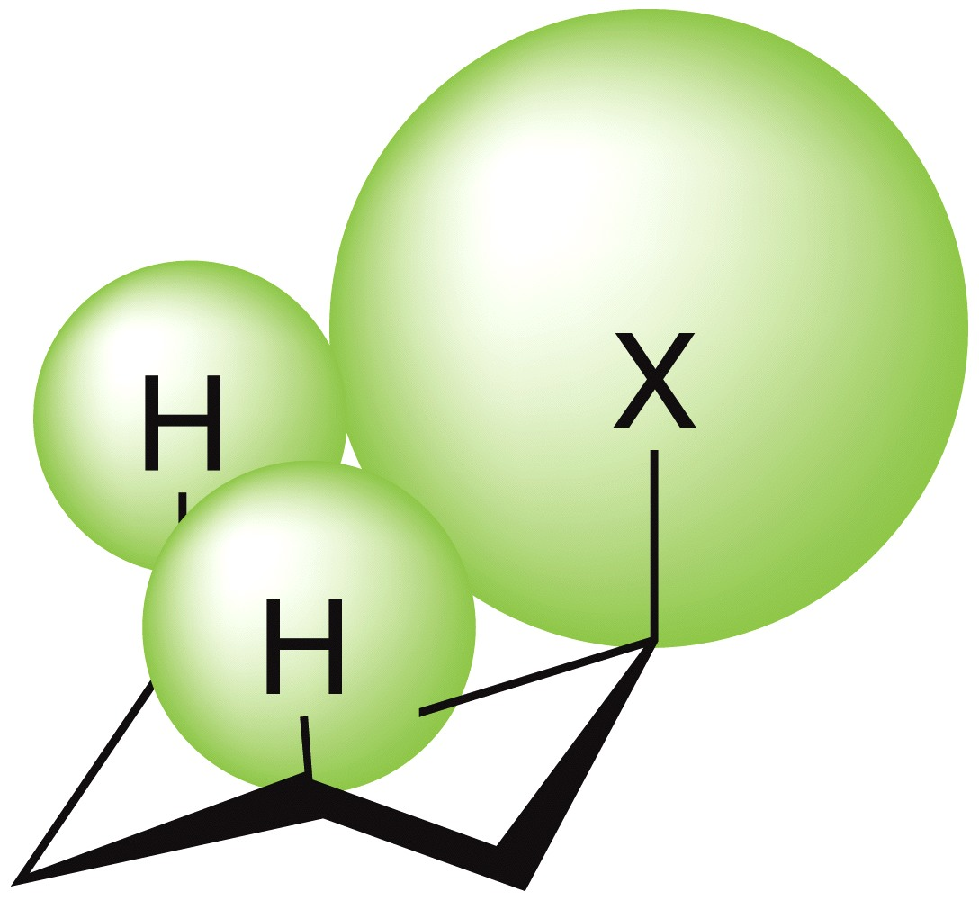
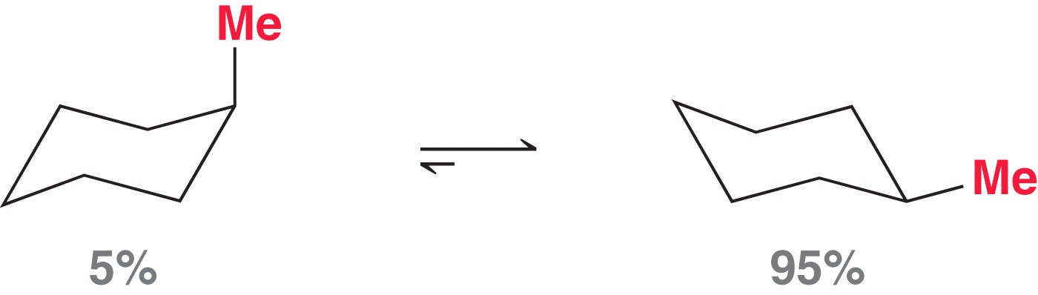
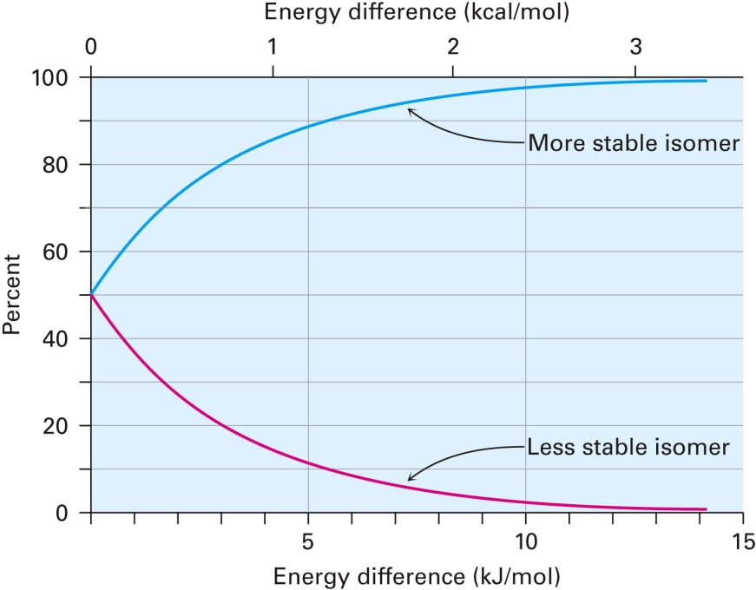
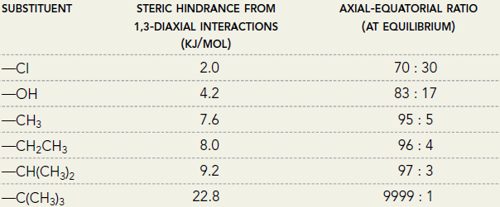
Larger Substituents Prefer Equatorial Position

Slide 22
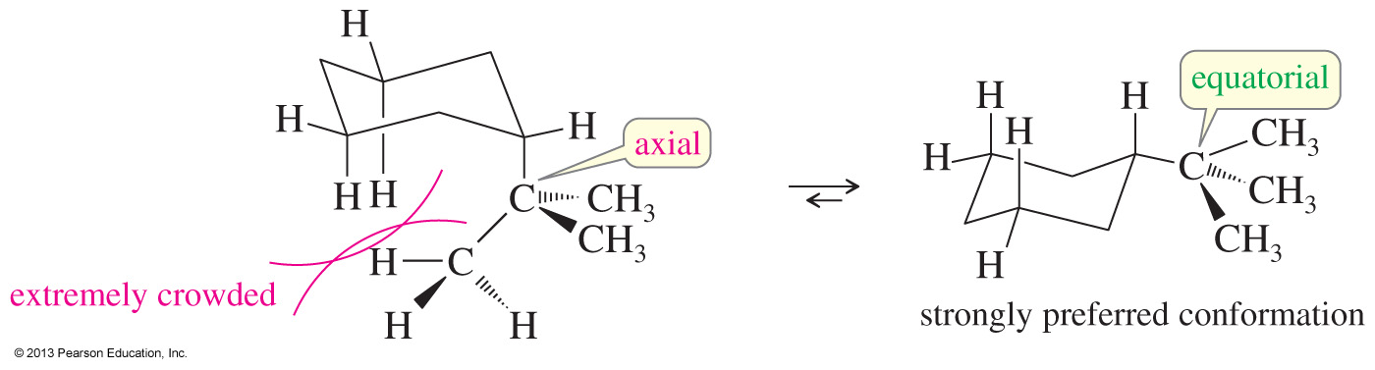
Tert-Butyl Cyclohexane
Preference for equatorial position is very strong.
Often employed as a locking group i.e. if a tert-butyl group is present, it “locks” the molecule in a conformation in which it is equatorial.
>99.99%

Slide 23
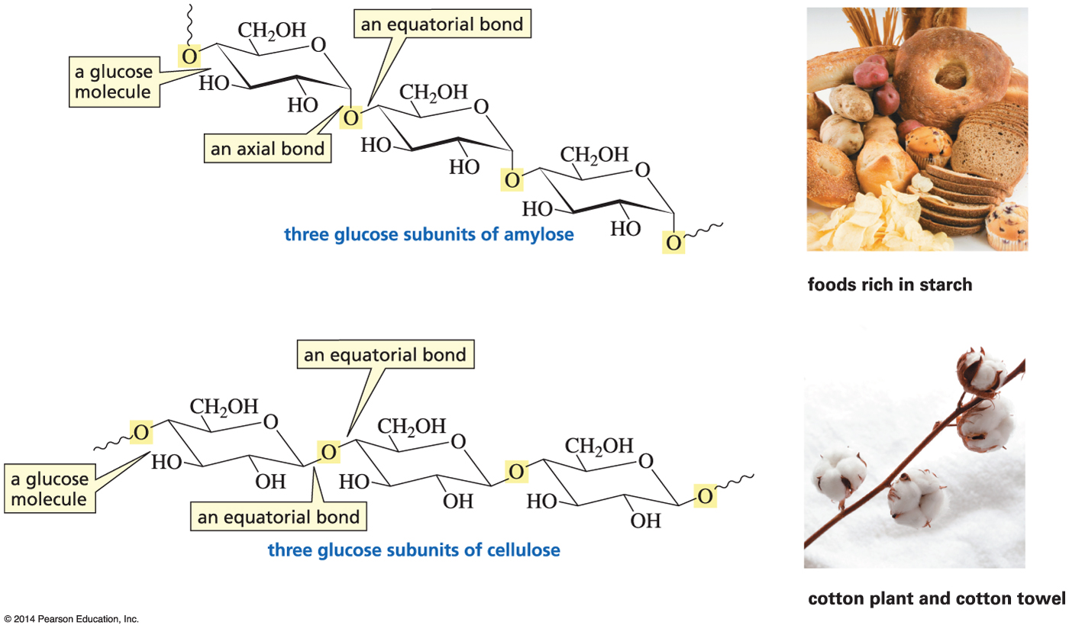
What Impact Can Axial vs Equatorial Possibly Have?
The only difference between starch and cotton is axial vs an equatorial bond!

Slide 24
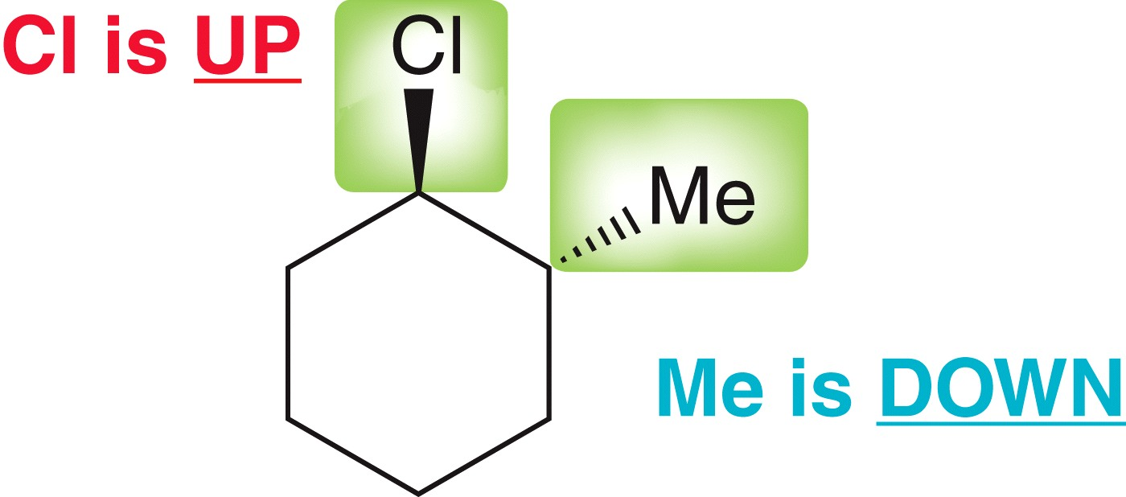
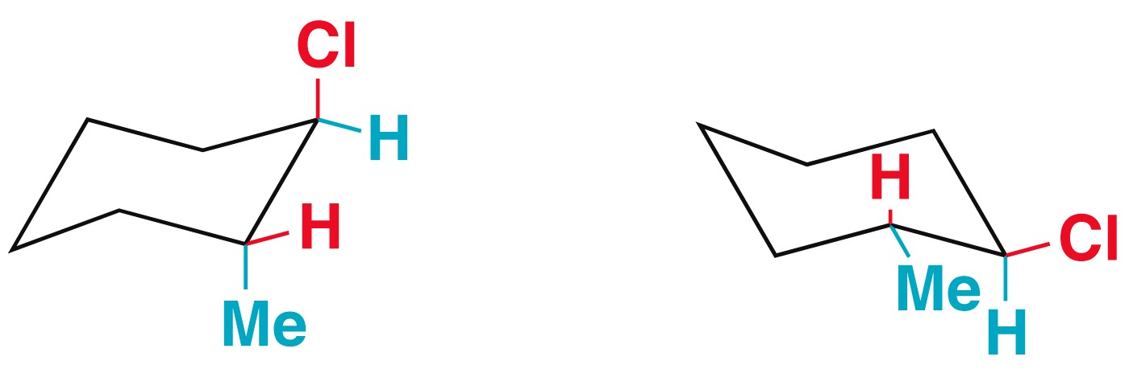
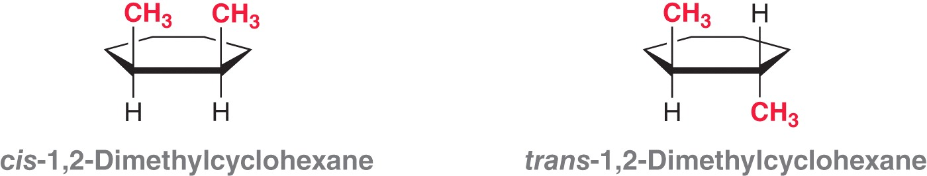
Disubstituted Cyclohexanes
With multiple substituents, solid or dashed wedges are used to show positioning of the groups or by showing the groups in either axial or equatorial positions
An “UP” substituent could be axial or equatorial depending on how the ring is flipped
When naming a disubstituted cycloalkane, use the prefix cis when there are two groups on the same side of the ring
Use the prefix trans when two substituents are on opposite sides of a ring

Slide 25
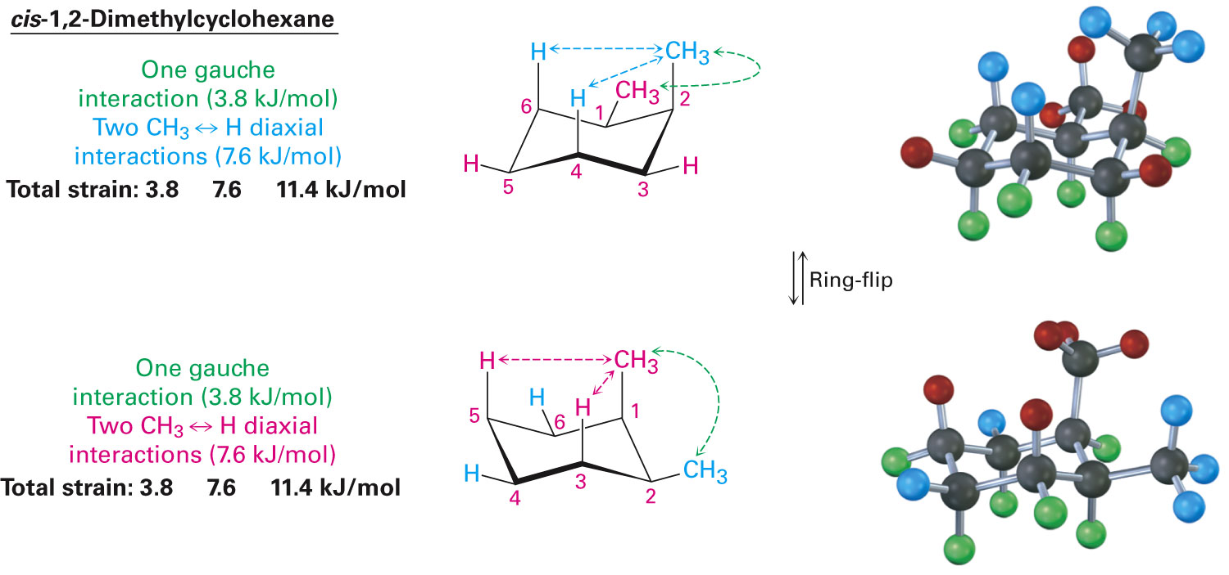
Conformations of Disubstituted Cyclohexanes
In disubstituted cyclohexanes, the steric effects of both substituents must be taken into account in both conformations
Consider cis-1,2-dimethylcyclohexane
Consider the sum of all interactions
In cis-1,2-dimethylcyclohexane both conformations are equal in energy

Slide 26
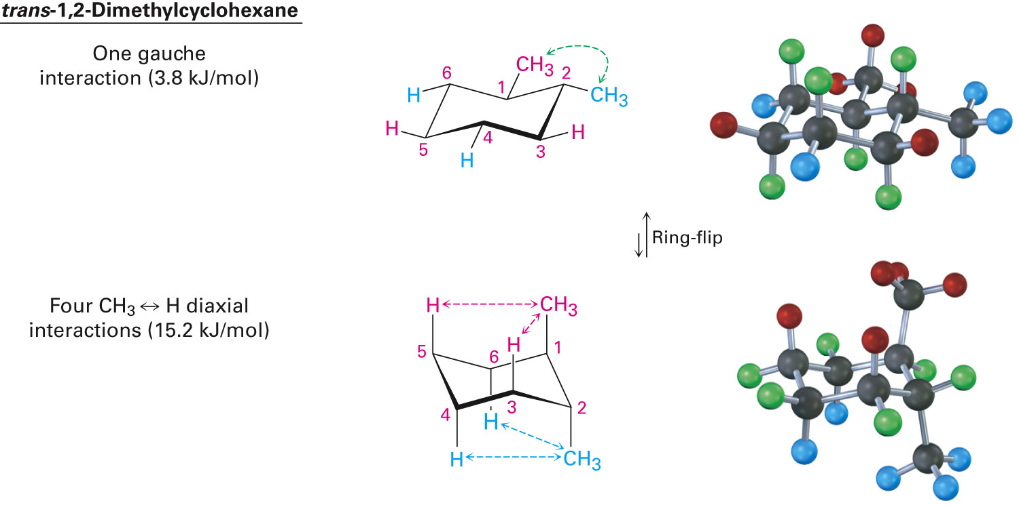
trans-1,2-Dimethylcyclohexane
One trans conformation has both methyl groups equatorial and only a gauche butane interaction between methyls (3.8 kJ/mol) and no 1,3-diaxial interactions
The ring-flipped conformation has both methyl groups axial with four 1,3-diaxial interactions
Steric strain of 4 x 3.8 kJ/mol = 15.2 kJ/mol makes the diaxial conformation 11.4 kJ/mol less favorable than the diequatorial conformation
trans-1,2-dimethylcyclohexane will exist almost exclusively (>99%) in the diequatorial conformation

Slide 27
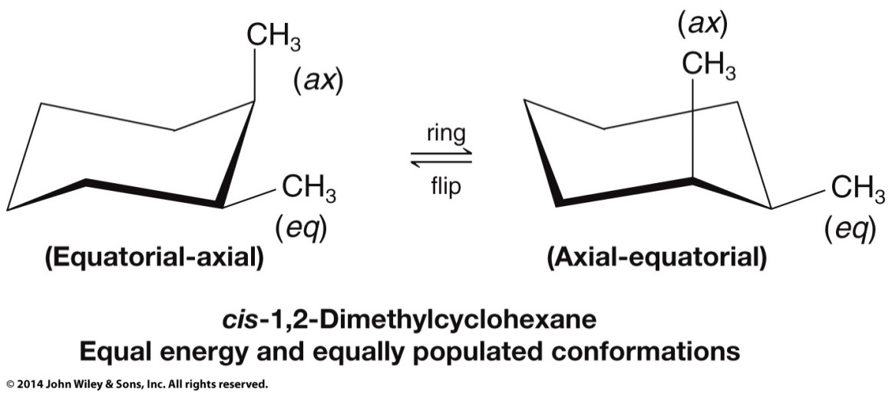
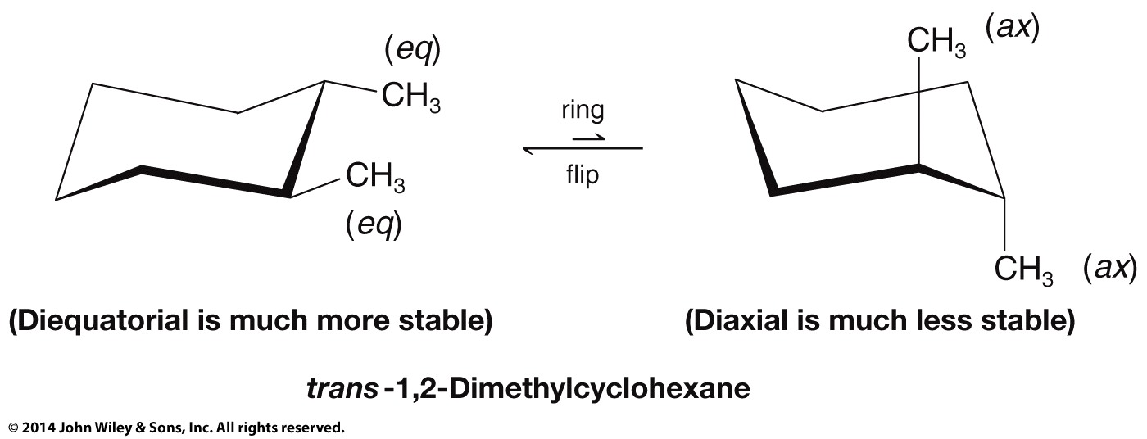
Is Energy Calculation Necessary to Determine Most Stable Conformer?
Knowing that a substituent prefers the equatorial position, simply determining the number of axial and equatorial substituents in each flipped conformation will tell the answer.

Slide 28
Relationship Between Substituents in Dimethyl Cyclohexanes

Slide 29
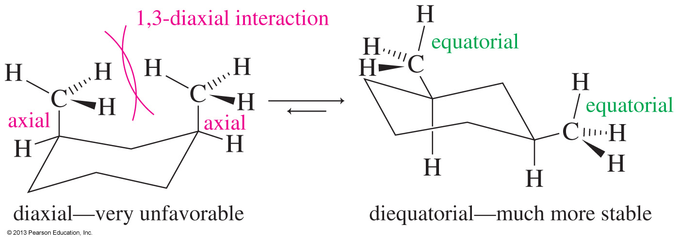
cis-1,3-Dimethylcyclohexane
Cis-1,3-dimethylcyclohexane can have both methyl groups in axial positions or both in equatorial positions.
The conformation with both methyl groups being equatorial is more stable.

Slide 30
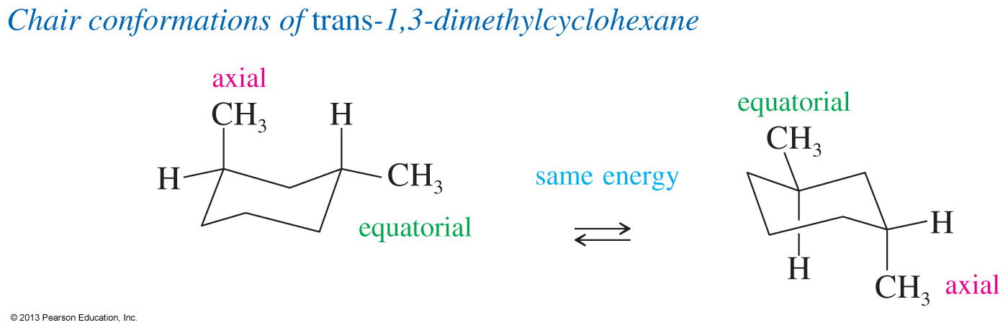
trans-1,3-Dimethylcyclohexane
Both conformations have one axial and one equatorial methyl group so they have the same energy.

